Slide 1

Facial Recognition

Slide 2
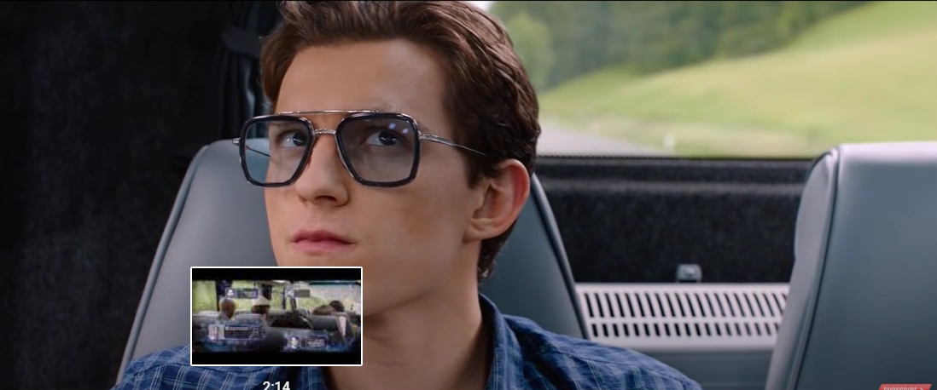
An application of facial recognition from the movie spiderman

Slide 3
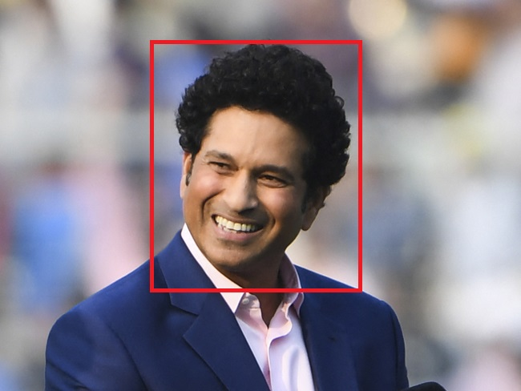
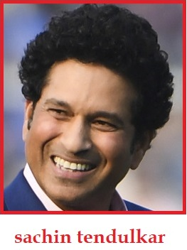
Proposed Approach
1 . Detecting Region of interest
2 . Detecting the person in the region of interest

Slide 4
1 . Detecting Region of interest
1 . Determine what your region of interest is. (in our case Face)
2 . Collect/create a data set to train a model to detect region of interest and predict bounding box values (The data set is generally fairly large at least 300 images to make decent predictions and ideally the number of images in training data should be much larger)
3 . Apply data augmentation techniques on collected data set to increase the accuracy of the model and to make the predictions dynamic
4 . Create a model with suitable number of layers to extract the necessary features and fine tune the model to get desirable accuracy.

Slide 5
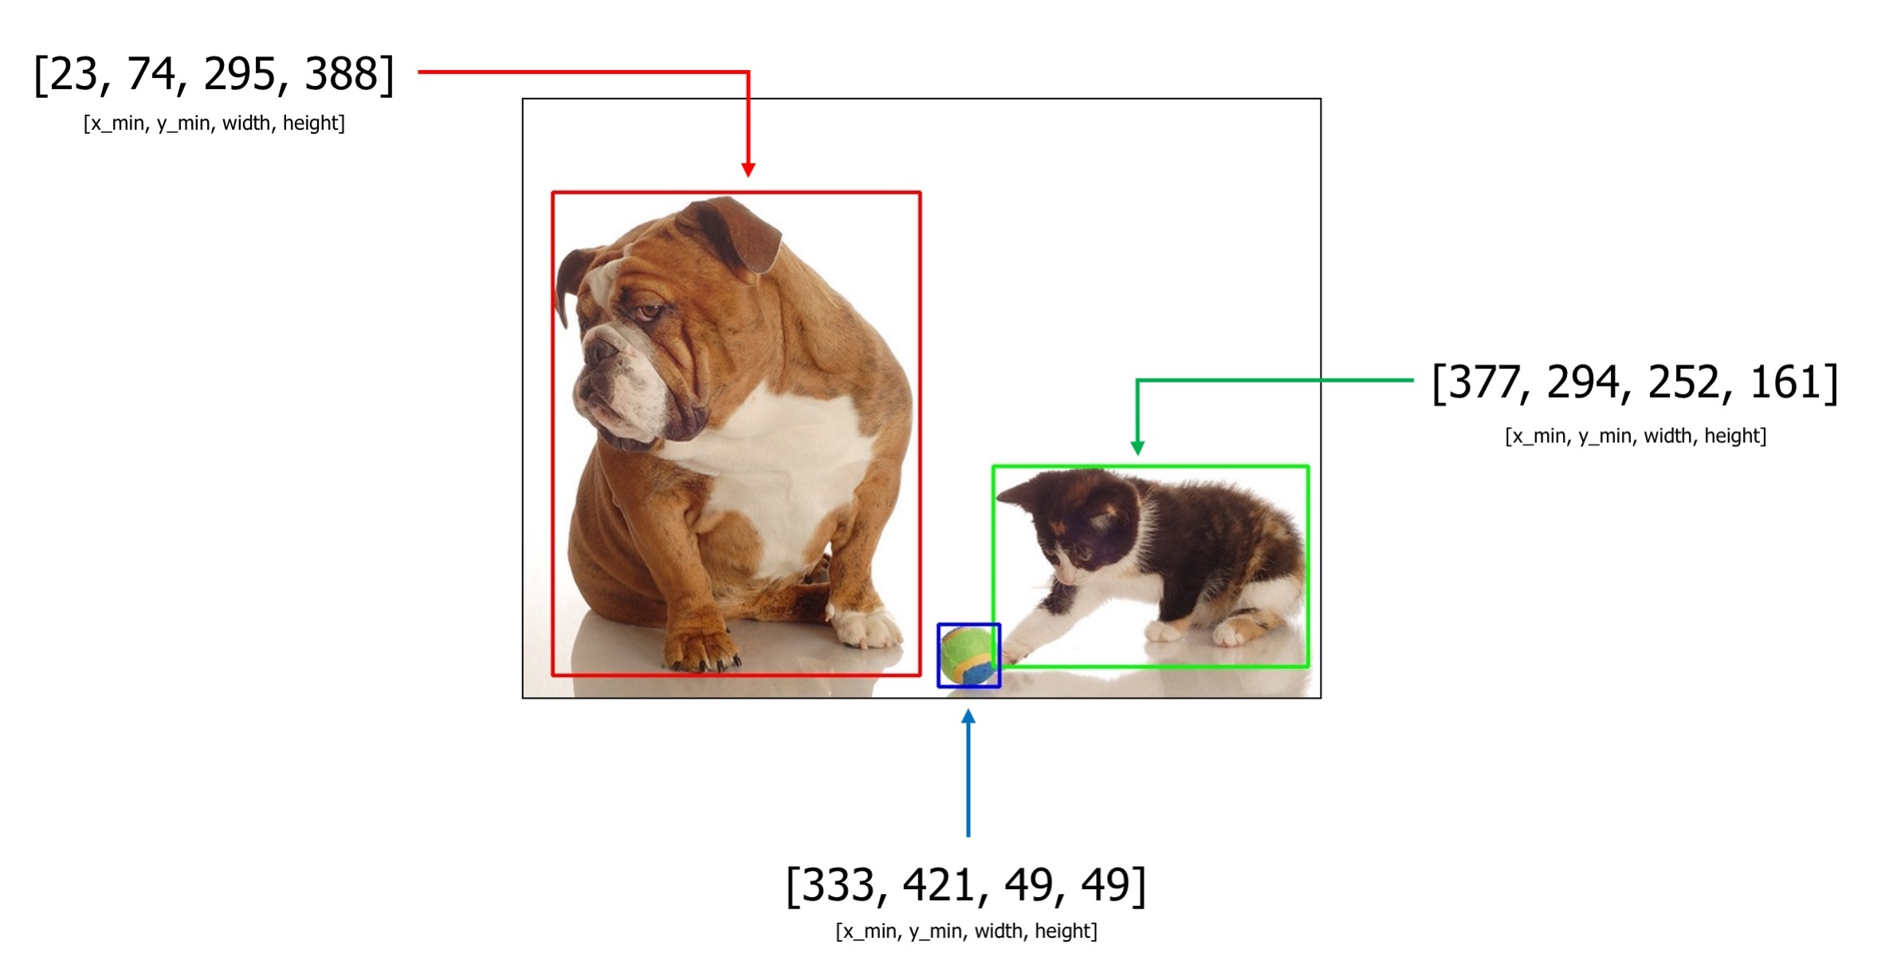
Bounding Box Values

Slide 6
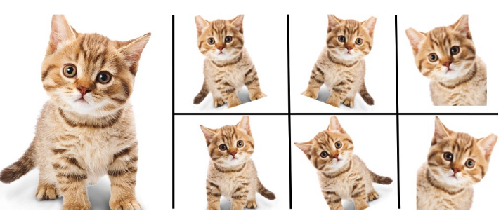
Data Augmentation
Position augmentation
Scaling
Cropping
Flipping
Padding
Rotation
Translation
Affine transformation
Color augmentation
Brightness
Contrast
Saturation
Hue

Slide 7
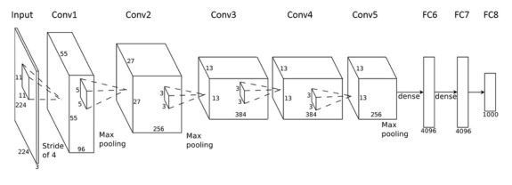
Creating a model to detect ROI

Slide 8
2 . Detecting the person in the region of interest
Deep CNNs have become best performing methods for image classification tasks.
In such Image related tasks using CNNs require a lots of labelled data which is one of the biggest limitations of using these algorithms.
In many real- life applications, (eg: Building a face recognition model), collecting this much data is very difficult or not feasible.

Slide 9
One short Learning (Siamese Network)
Siamese network is used to find we want to compare how similar two things are. Some examples of such cases are Verification of signature, face recognition, voice verification etc
A Siamese neural network is designed to naturally rank similarity between inputs.

Slide 10
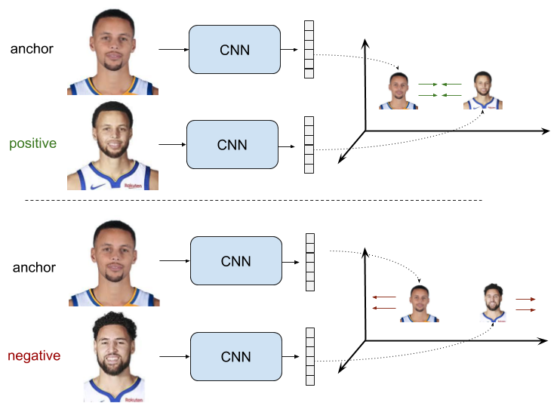
How is the data provided as input to a Siamese network
Positive Sample:
Negative Sample:

Slide 11
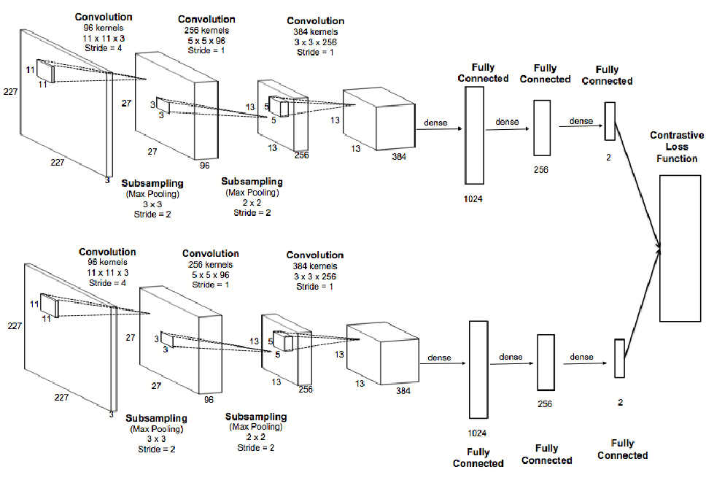
Siamese model architecture

Slide 12
Link
https://colab.research.google.com/drive/12NxBgOo5pMKdBrOKYShO8xlWOX9WmO0c?usp=sharing#scrollTo=qLff6MddNiFs

